Slide 1
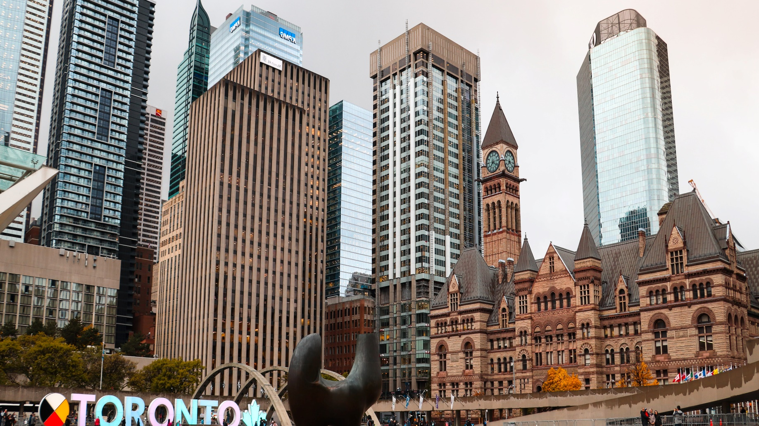
The Battle Of Neighborhoods
Best Place to start Coffee Shop business in Toronto

Slide 2
Business Problem
Let’s assume that some would like start Coffee Shop business in city Toronto. But they don’t know which place is better suited for them. To ensure this business success, business team requires insights into the demographics, neighbouring businesses, and crime rates. For each neighbourhood, we can ask:
How many cafes exist?
What are the most popular venues?
Can we get information about the vehicle and foot traffic?
What is the neighbourhoods’ crime rate? And so on.
Thus, the project goal is to figure out the best locations for starting-up a new coffee shop in Toronto City.

Slide 3
Data Requirements and collection
We need historical data about crime incidents, busiest roads, and popular venues. Luckily, Toronto has an open data portal that makes it public. We can also leverage Foursquare Location data to compare neighborhoods in terms of service. Hence, the followings are data sources that we can use for this project:
1st Data: The most updated record of traffic signal vehicle and pedestrian volumes in Toronto City.
2nd Data: The most updated record of crime incidents reported in Toronto City provided by Toronto Police Services.
3rd Data: The list of Toronto neighborhoods represented by postal codes and their boroughs.
4th Data: The popular or most common venues of a given neighborhood in Toronto.

Slide 4
Data Cleaning and Feature extraction
The first data is in a CSV file. It contains 2280 rows and 11 columns. The data is typically collected between 7:30 a.m. and 6:00 pm at intersections where there are traffic signals. Each intersection holds vehicle and pedestrian volumes data, along with its coordinates. We will focus on 5 columns; those are Main, 8 Peak hour Pedestrian Volume, 8 Peak hour Vehicle Volume, Latitude, and Longitude. We will use these features to diagnose each main road's characteristics and locate the busiest main roads in the city.
The second data is also in a CSV file. It contains 206,435 rows and 9 columns. The rows represent crime incidents that reported from 2014 to 2019. It has 5 Major Crime Indicators (MCIs) scattered to 17 divisions and 140 listed neighborhoods. We will group the data based on division and get statistics about crime rates.
The third data is a Wikipedia page about Toronto postal code. We will scrape the page and create a data frame consisting of three columns; Postal Code, Borough, and Neighborhood. We remove any rows that do not have borough assigned. Then, we will be using the Geocoder python package to retrieve the postal code's coordinates. It will return 103 rows and 5 columns.
The fourth data is stored inside Foursquare Location Data, and we will use Foursquare API to access it. We utilize the postal coordinates to retrieve popular venues around a specific radius. As a result, the same venue categories will be returned to different neighborhoods. We can use this idea to cluster the neighborhoods based on their venues representing services and amenities.

Slide 5

Analytic Approach
We will display any statistics needed to answer questions concerning crime incidents, and vehicle and foot traffic records.
Then, we approach the problem using the clustering technique, namely k-Means. We can then examine each cluster and determine the discriminating venue categories that distinguish each cluster.
k-Means is one of the common machine learning algorithms used to cluster data points based on similar characteristics. The algorithm is fast and efficient for a medium and large-sized database and is useful to discover insights from unlabelled data quickly.

Slide 6
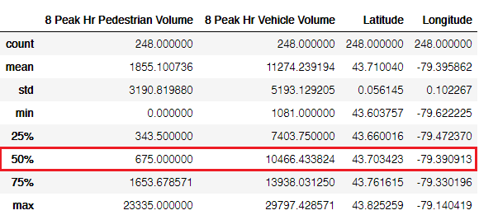
Vehicle and Foot Traffic
Pedestrian and vehicle volumes after being grouped by the main road.
The statistics summary of pedestrian and vehicle volumes during peak hour.

Slide 7
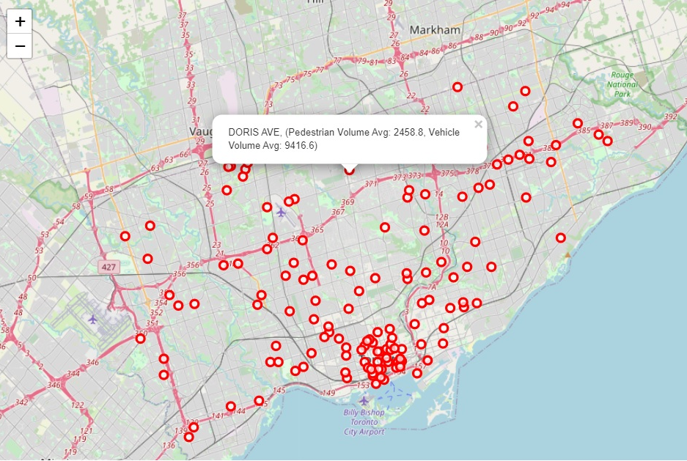
We want our candidate neighborhoods to be lively. Hence, we filter out the roads. In this example, we only show the roads with an average of pedestrian volume above 1,200 or vehicle volume above 12,000 during peak hour (above ~70%). This gives us 139 main roads.

Slide 8
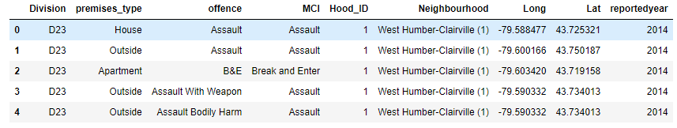
Crime Statistics
Next, we analyze the crime statistics from 2014 to 2020. It gives us 206,435 crime incidents segmented by police divisional boundaries, neighborhoods, and Major Crime Indicators (MCI). Toronto Police Service divides the major crimes into 5 categories scattered to 17 divisions and 140 neighborhood IDs.

Slide 9
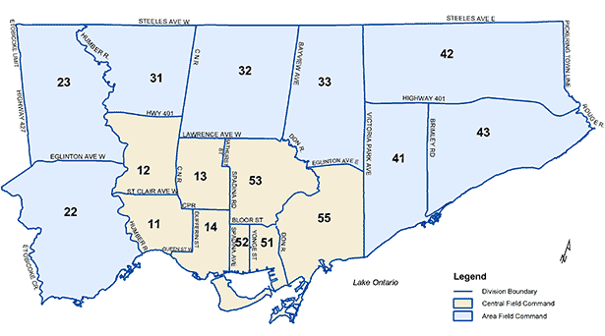
Toronto Police Service Divisional Boundaries

Slide 10
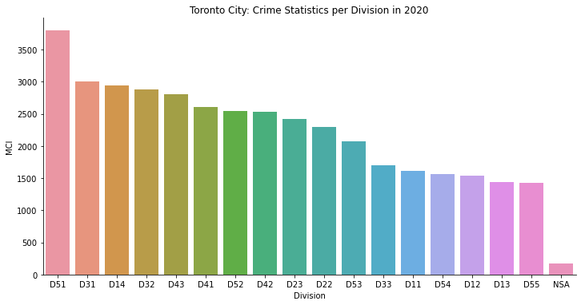
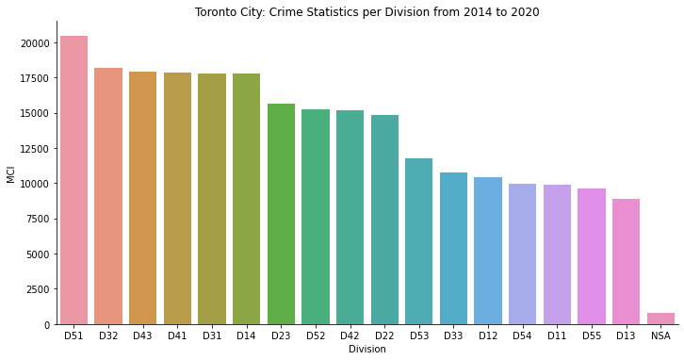
Toronto Crime Statistics
Here we can see in which divisions crime rate is high and low easily. And we can decide our place in a safe division

Slide 11
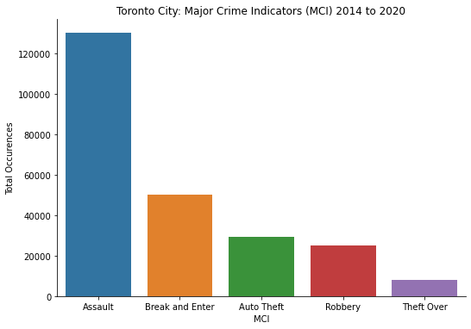
MCI from 2014 to 2020
Among the 5 MCI, Assault incidents are still number one occurred the most for 6 consecutive years. During the same period, several divisions are consistent about their crime rates.

Slide 12
Inferences from above graphs and images
High Crime Rates (D51, D43, D41, D32, D31, D14)
Middle Crime Rates (D52, D42, D23, D22)
Low Crime Rates (D55, D54, D53, D33, D13, D12, D11)
Finally, to pick the area of interest, the candidates are expected to be:
safe - having low crime rates
lively - crowded by people, vehicles, and easy to access close to downtown.
Therefore, the divisions qualified are D55, D54, D53, and D13. These divisions cover:
Central Toronto (D53)
East York (D53, D54, D55)
York (D13)
D11, D12 are mostly west end of Toronto which are safe but not lively. In the next section, we will explore the neighborhoods inside Central Toronto, East York, and York as the selected boroughs.

Slide 13
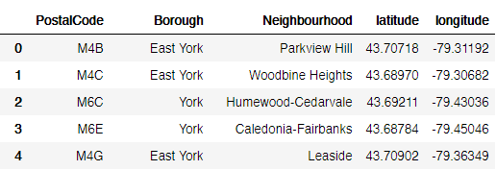
Neighborhoods Analysis
The first 5 neighborhoods of the selected boroughs

Slide 14
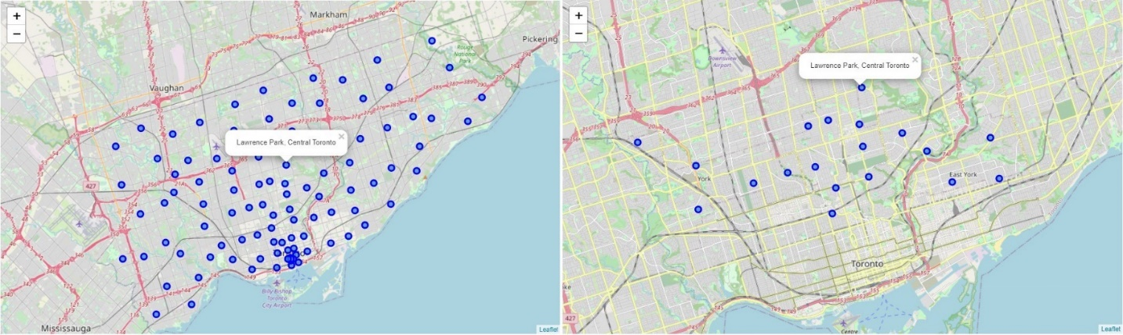
Left — the map of city neighborhood distribution. Right —The neighborhood distribution for Central Toronto, East York, and York.

Slide 15
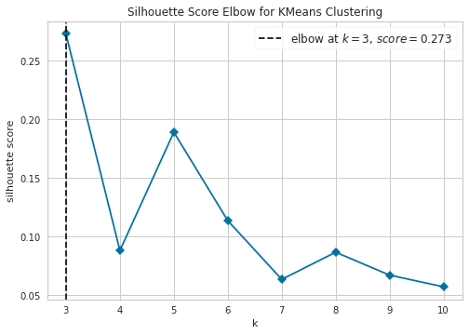
Clustering the Neighborhoods
Finding best cluster value using KElbow Visualiaser .

Slide 16
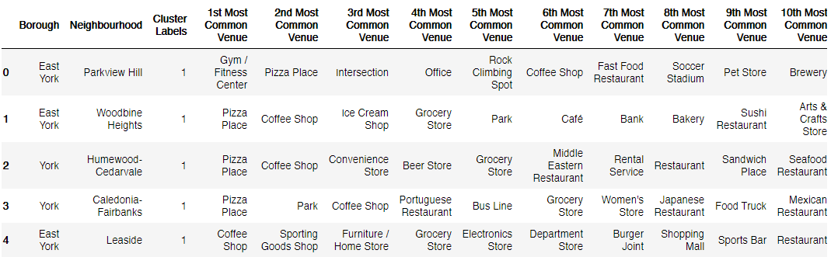
Neighborhoods and their Cluster Labels
The result of k-Means with k = 3. Now, the table has a cluster label for each neighborhood. Along with their top 10 venues near by.

Slide 17
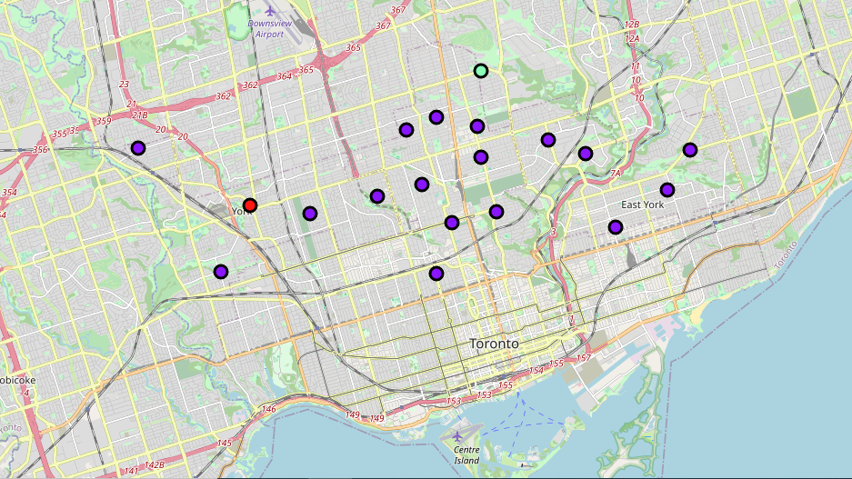
Results
Best Neighborhoods for Coffee Shop Business are clustered based on their respective near-by venues.

Slide 18
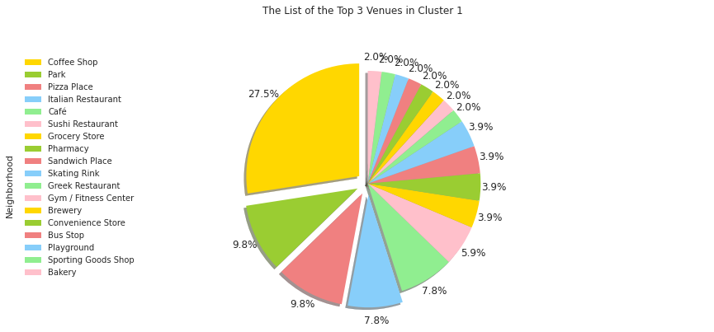
Top 3 venues in Cluster 1

Slide 19
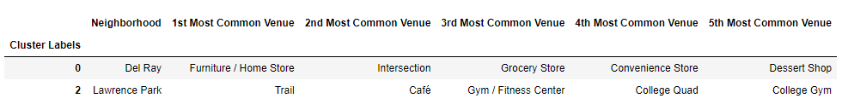
The list of the Top 5 Venues in Cluster 0, Cluster 2

Slide 20
Clusters and their Top Venues
Cluster 0: “Stores”
The first cluster contains 1 neighborhood only, with the Stores as the first most common venue.
Cluster 1: “Coffee Shop and Restaurant Venues”
The second cluster holds 16 neighborhoods, with the coffee shop, restaurant, and Cafe venues appear to be the most common ones.
Cluster 2: “Gym and Fitness Center”
The third cluster includes 1 neighborhood with Gym and Fitness Center as the most occurrence venue category.

Slide 21
Discussion
The project’s main goal is to determine the best location for opening a coffee shop business in Toronto. Discussing what locations can be considered “the best” may vary, but we can equate it as the most conducive ones by considering the following criteria:
1.Safety
The conducive locations are supposed to be safe; hence we analyze the crime statistics for all divisions of Toronto Police Service. We conclude that divisions D55, D54, D53, D33, D13, D12, D11 have the lowest crime rates. These cover Central Toronto, West Toronto, York, and East York.
--Continued

Slide 22
Discussion
2. Demographics and Accessibility
Vehicle and foot traffic are important when we choose a location for the new coffee shop. We have shown the busiest main roads in the city where many are located around downtown. Then, we consider focusing on Central Toronto, York, and East York at first. However, this would come to waste if those people are not our target demographic. Hence, we need to understand the target market and discuss it further with the team.
Accessibility is also another part to consider. Soon, if we have picked a few location candidates, knowing how and why your customers will get to your location are crucial, such as street visibility, parking slot, and location convenience. Thus, further discussion with the team is again needed.
3.Neighboring businesses
Neighboring businesses can affect the profitability both positively and negatively.
Cluster 1 has the most coffee shops and restaurants in their neighborhoods. Although these businesses can be in different categories, they could all contend with the products you serve. Therefore, cluster 1 is not recommended.
Cluster 0 and 2 are recommended neighborhoods to inspect further. However, it is also wise to consider other businesses or amenities surrounding the area to complement your offerings. For example, if we target people who spend their morning or afternoon outside, cluster 0 might be a good choice since it has “Stores” as the most common venue.

Slide 23
Conclusion
Finding the best location to start a business can be challenging and quite frustrating due to many uncertainties. However, we can quickly gain meaningful insights into the city and its neighborhoods with data available today. This helps everyone, including entrepreneurs, business owners, and stakeholders, to make solid decisions based on facts.

Slide 24
References
1.Traffic signal vehicle and pedestrian volumes in Toronto City
Source: https://ckan0.cf.opendata.inter.prod-toronto.ca/tl/dataset/traffic-signal-vehicle-and-pedestrian-volumes
2.Record of crime incidents reported in Toronto City
Source: https://data.torontopolice.on.ca/datasets/4c97cd402c20464a8831adecd1e1c46f_0/explore?location=43.819724%2C-79.295286%2C9.33&showTable=true
3. List of postal codes of Canada :M Toronto City
Source: https://en.wikipedia.org/wiki/List_of_neighbourhoods_in_Toronto
4. The popular or most common venues of a given neighborhood in Toronto
Source: https://developer.foursquare.com/

